Slide 1

3.6 Dynare输出和状态空间表示的联系

Slide 2
Outline
Order one and State Space Representation
How it related to Dynare output?
The 2nd order solution in Dynare.

Slide 3
Structural State Space Representation
The transition and measurement equations:
The above is the state space representation of solution, Phi is the policy function.

Slide 4
Structural State Space Representation
Then we can write out the whole system as:
See PDF notes for details.
The Dynare output of policy and transition function which is stored in oo_.dr object is somewhat different from what see above.

Slide 5
How it related to Dynare output?
Dynare representation for solution is almost the same as the state space representation.
Only the order is slightly different.
Printing is in declaration order:
POLICY AND TRANSITION FUNCTIONS
But Storage of the solution is in DR order

Slide 6
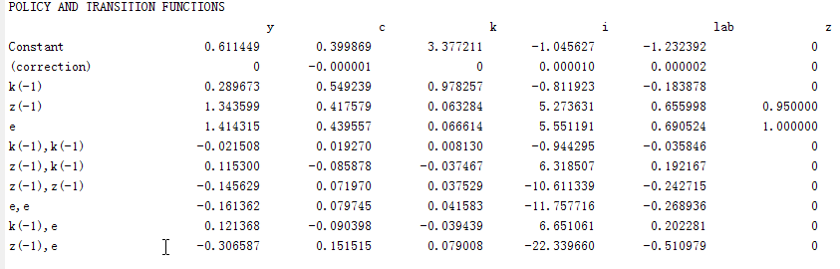
POLICY AND TRANSITION FUNCTIONS
This is the 2nd order solution

Slide 7
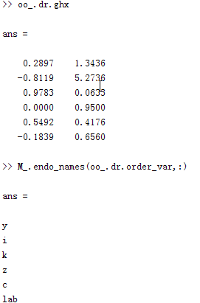
DR order and matrix E

Slide 8
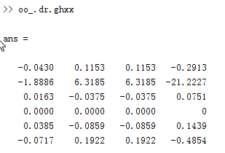
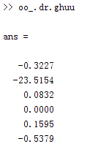
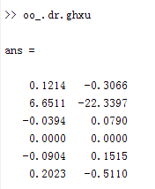
2nd solution coeff. matrices

Slide 9
Summary
I. For order one: The Dynare output of policy and transition function which is stored in oo_.dr object is somewhat different from the state space representation. Only the order is different.
II. For order Two: there are no state space representation of the solution because there are 2nd order terms show up in the solution.

Slide 10
Thanks！

